Slide 1
Pandas, Part I
LECTURE 2
Introduction to pandas syntax, operators, and functions
Data 100/Data 200, Fall 2024 @ UC Berkeley
Narges Norouzi and Joseph E. Gonzalez

Slide 2
Goals for This Lecture
Introduce pandas, an important Python library for working with data
Key data structures: DataFrames, Series, Indices
Extracting data: loc, iloc, []
This is the first of a three-lecture sequence about pandas.
Get ready: lots of code incoming!
Lecture: introduce high-level concepts
Lab, homework: practical experimentation
Lecture 02, Data 100 Fall 2024

Slide 3
Agenda
Tabular data
Series, DataFrames, and Indices
Data extraction with loc, iloc, and []
Lecture 02, Data 100 Fall 2024

Slide 4
Tabular Data
Tabular data
Series, DataFrames, and Indices
Data extraction with loc, iloc, and []
Lecture 02, Data 100 Fall 2024

Slide 5


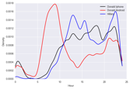
Recall the Data Science Lifecycle
?
Question & Problem
Formulation
Data
Acquisition
Prediction and
Inference
Exploratory Data Analysis
Reports, Decisions, and Solutions
Notes:
Slightly formalized in wording, but still mostly the same:
Ask a Question
Obtain Data
Understand the Data
Understand the World

Slide 6

Plan for First Few Weeks
?
Question & Problem
Formulation
Data
Acquisition
Prediction and
Inference
Exploratory Data Analysis
Reports, Decisions, and Solutions
(Weeks 1 and 2)
(Weeks 2 and 3)
Exploring and Cleaning Tabular Data
From datascience to pandas
Data Science in Practice EDA, Data Cleaning, Text processing (regular expressions)

Slide 7
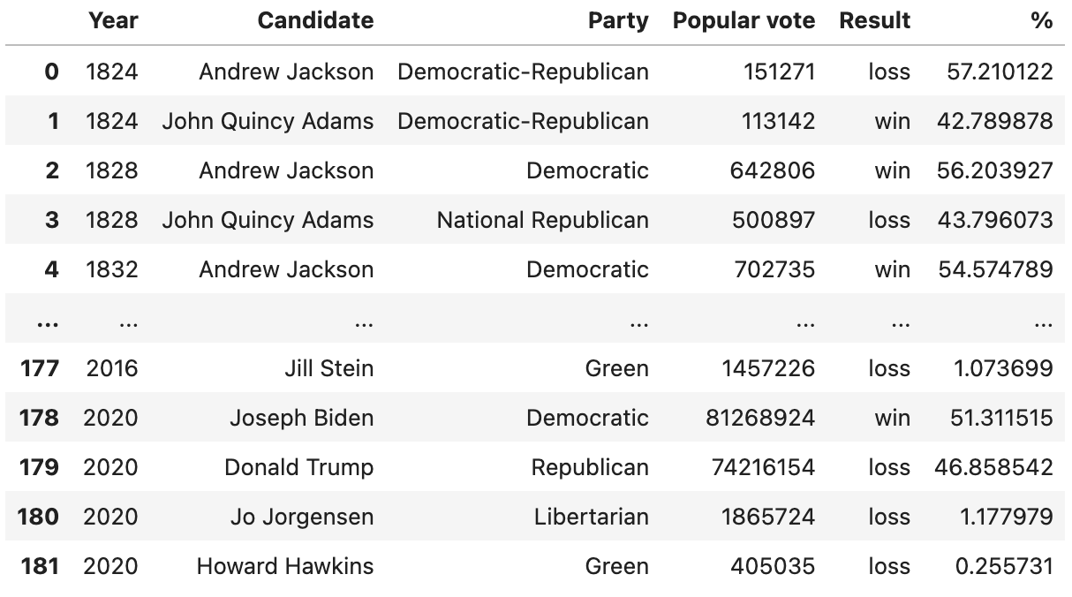
Data Scientists Love Tabular Data
"Tabular data" = data in a table.
Typically:
A row represents one observation (here, a single person running for president in a particular year).
A column represents some characteristic, or feature, of that observation (here, the political party of that person).
In Data 8, you worked with the datascience library using Tables.
In Data 100 (and beyond), we’ll use an industry-standard library called pandas.

Slide 8

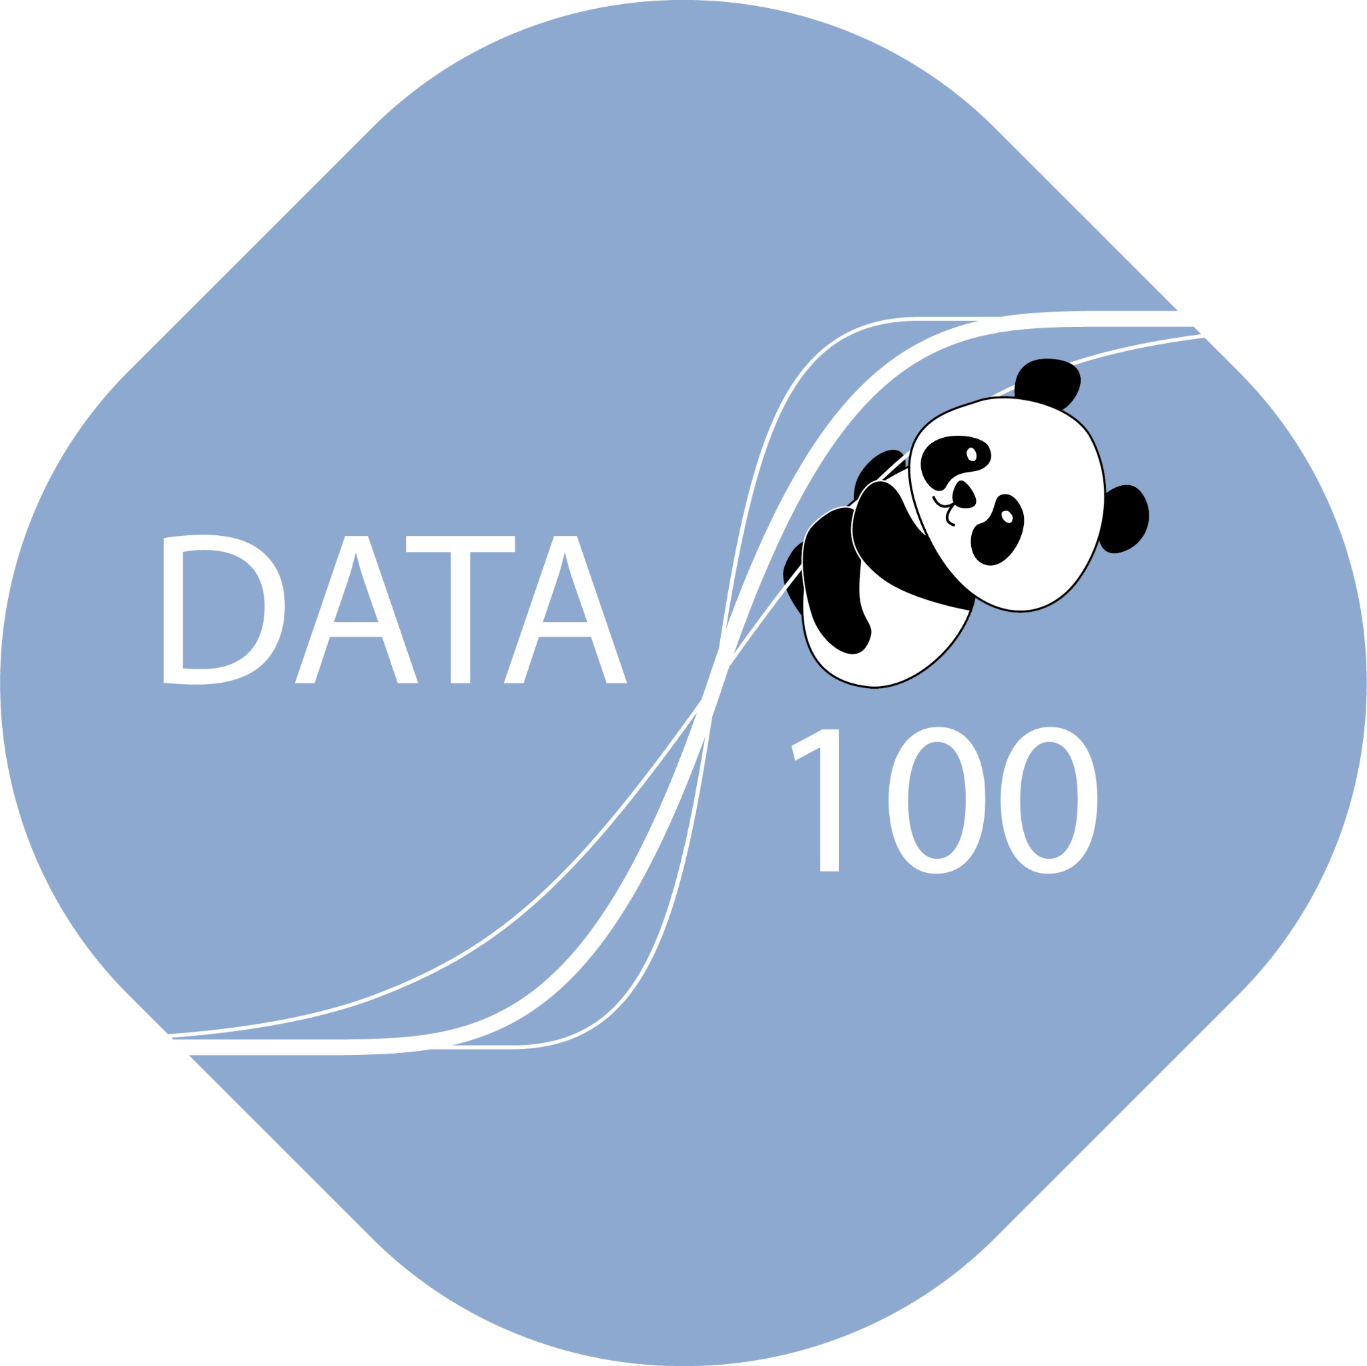
Introducing the Standard Python Data Science Tool: pandas
Stands for "panel data"
The Python Data Analysis Library
a cartoon panda
The (unofficial) Data 100 logo

Slide 9
Introducing the Standard Python Data Science Tool: pandas
Using pandas, we can:
Arrange data in a tabular format.
Extract useful information filtered by specific conditions.
Operate on data to gain new insights.
Apply NumPy functions to our data (our friends from Data 8).
Perform vectorized computations to speed up our analysis (Lab 1).
pandas is the standard tool across research and industry for working with tabular data.
The first two weeks of Data 100 will serve as a "bootcamp" in helping you build familiarity with operating on data with pandas.
Your Data 8 knowledge will serve you well! Much of our work will be in translating syntax.

Slide 10
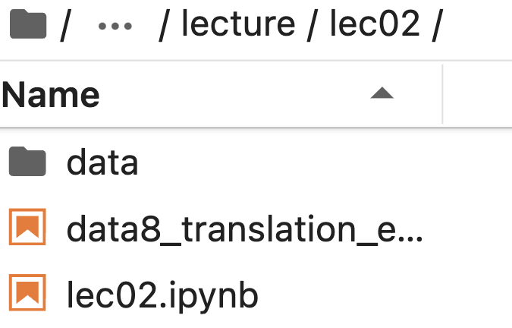
Contents
Data used in this lecture
Unofficial datascience -> pandas translations
Primary notebook for lecture

Slide 11
DataFrames, Series, and Indices
Tabular data
DataFrames, Series, and Indices
Data extraction with loc, iloc, and []
Lecture 02, Data 100 Fall 2024

Slide 12
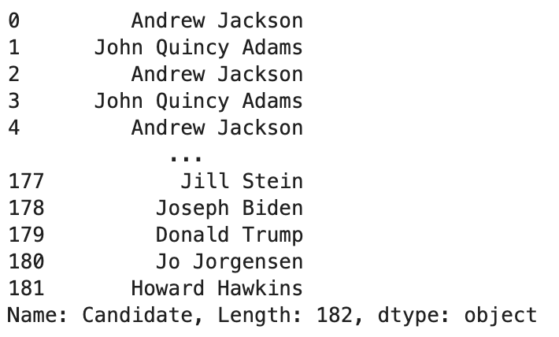
DataFrames
In the "language" of pandas, we call a table a DataFrame.
We think of DataFrames as collections of named columns, called Series.
A DataFrame
A Series named "Candidate"

Slide 13
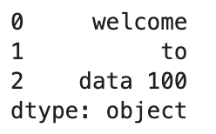
Series
A Series is a 1-dimensional array-like object. It contains:
A sequence of values of the same type.
A sequence of data labels, called the index.
pd is the conventional alias for pandas
import pandas as pd
s = pd.Series(["welcome", "to", "data 100"])
Index, accessed by calling s.index
Values, accessed by calling s.values

Slide 14
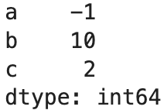
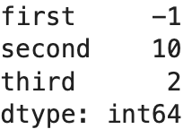
Series - Custom Index
We can provide index labels for items in a Series by passing an index list.
s = pd.Series([-1, 10, 2], index = ["a", "b", "c"])
s.index
A Series index can also be changed.
s.index = ["first", "second", "third"])
s.index

Slide 15
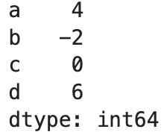
Selection in Series
We can select a single value or a set of values in a Series using:
A single label
A list of labels
A filtering condition
s = pd.Series([4, -2, 0, 6], index = ["a", "b", "c", "d"])

Slide 16
Selection in Series
We can select a single value or a set of values in a Series using:
A single label
A list of labels
A filtering condition
s = pd.Series([4, -2, 0, 6], index = ["a", "b", "c", "d"])
s["a"]

Slide 17
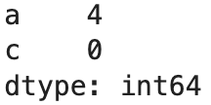
Selection in Series
We can select a single value or a set of values in a Series using:
A single label
A list of labels
A filtering condition
s = pd.Series([4, -2, 0, 6], index = ["a", "b", "c", "d"])
s[["a", "c"]]

Slide 18
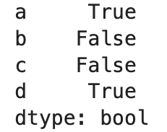
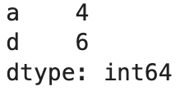
Selection in Series
We can select a single value or a set of values in a Series using:
A single label
A list of labels
A filtering condition
s = pd.Series([4, -2, 0, 6], index = ["a", "b", "c", "d"])
Say we want to select values in the Series that satisfy a particular condition:
Apply a boolean condition to the Series. This creates a new Series of boolean values.
Index into our Series using this boolean condition. pandas will select only the entries in the Series that satisfy the condition.
s > 0
s[s > 0]

Slide 19
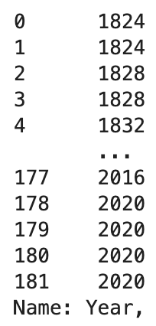
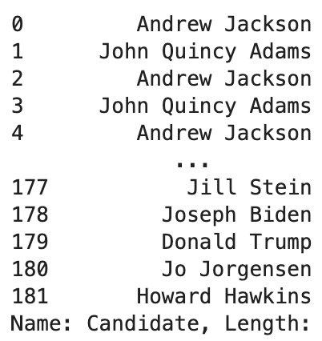
DataFrames of Series!
Typically, we will work with Series using the perspective that they are columns in a DataFrame.
We can think of a DataFrame as a collection of Series that all share the same Index.
[...]
The Series "Year"
The Series "Candidate"
The DataFrame elections
Non-native English speaker note: The plural of "series" is "series". Sorry.

Slide 20
Creating a DataFrame
The syntax of creating DataFrame is:
pandas.DataFrame(data, index, columns)
Many approaches exist for creating a DataFrame. Here, we will go over the most popular ones.
From a CSV file.
Using a list and column name(s).
From a dictionary.
From a Series.

Slide 21
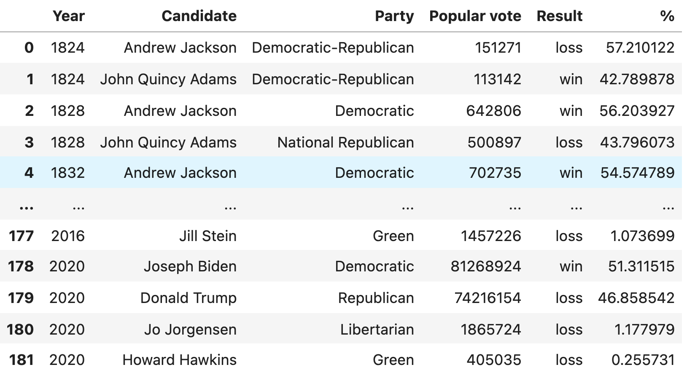
Creating a DataFrame
The syntax of creating DataFrame is:
pandas.DataFrame(data, index, columns)
Many approaches exist for creating a DataFrame. Here, we will go over the most popular ones.
From a CSV file.
Using a list and column name(s).
From a dictionary.
From a Series.
elections = pd.read_csv("data/elections.csv")
The DataFrame elections

Slide 22
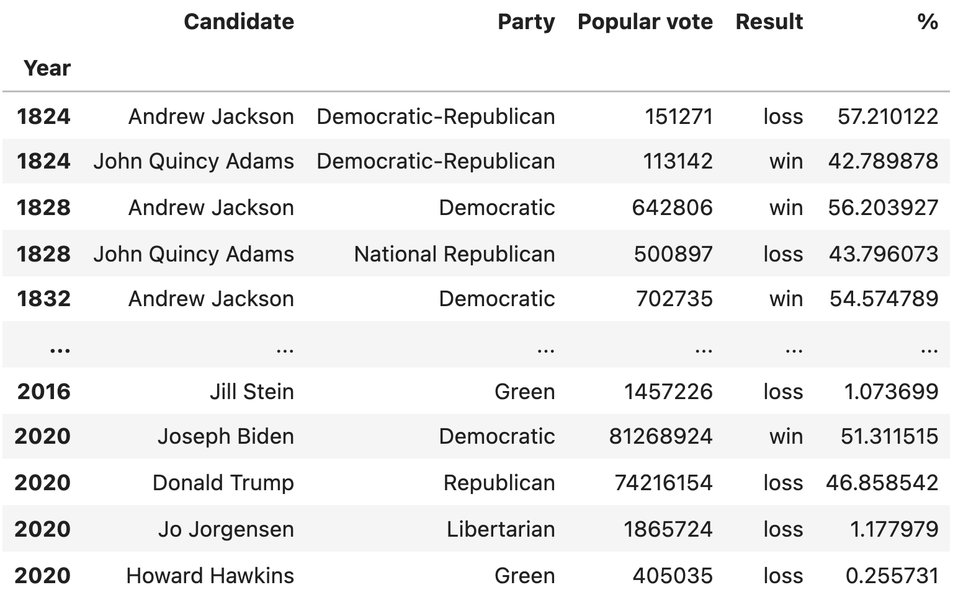
Creating a DataFrame
The syntax of creating DataFrame is:
pandas.DataFrame(data, index, columns)
Many approaches exist for creating a DataFrame. Here, we will go over the most popular ones.
From a CSV file.
Using a list and column name(s).
From a dictionary.
From a Series.
elections = pd.read_csv("data/elections.csv", index_col="Year")
The DataFrame elections with "Year" as Index

Slide 23
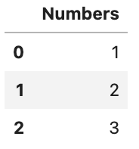
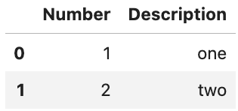
Creating a DataFrame
Many approaches exist for creating a DataFrame. Here, we will go over the most popular ones.
From a CSV file.
Using a list and column name(s).
From a dictionary.
From a Series.
pd.DataFrame([1, 2, 3],
columns=["Numbers"])
pd.DataFrame([[1, "one"], [2, "two"]],
columns = ["Number", "Description"])

Slide 24
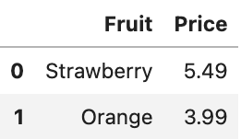
Creating a DataFrame
Many approaches exist for creating a DataFrame. Here, we will go over the most popular ones.
From a CSV file.
Using a list and column name(s).
From a dictionary.
From a Series.
Specify columns of the DataFrame
pd.DataFrame({"Fruit":["Strawberry", "Orange"],
"Price": [5.49, 3.99]})
pd.DataFrame([{"Fruit":"Strawberry", "Price":5.49},
{"Fruit":"Orange", "Price":3.99}])
Specify rows of the DataFrame

Slide 25
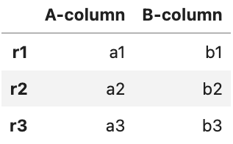
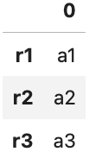
Creating a DataFrame
Many approaches exist for creating a DataFrame. Here, we will go over the most popular ones.
From a CSV file.
Using a list and column name(s).
From a dictionary.
From a Series.
s_a = pd.Series(["a1", "a2", "a3"], index = ["r1", "r2", "r3"])
s_b = pd.Series(["b1", "b2", "b3"], index = ["r1", "r2", "r3"])
pd.DataFrame({"A-column":s_a, "B-column":s_b})
pd.DataFrame(s_a)
s_a.to_frame()

Slide 26
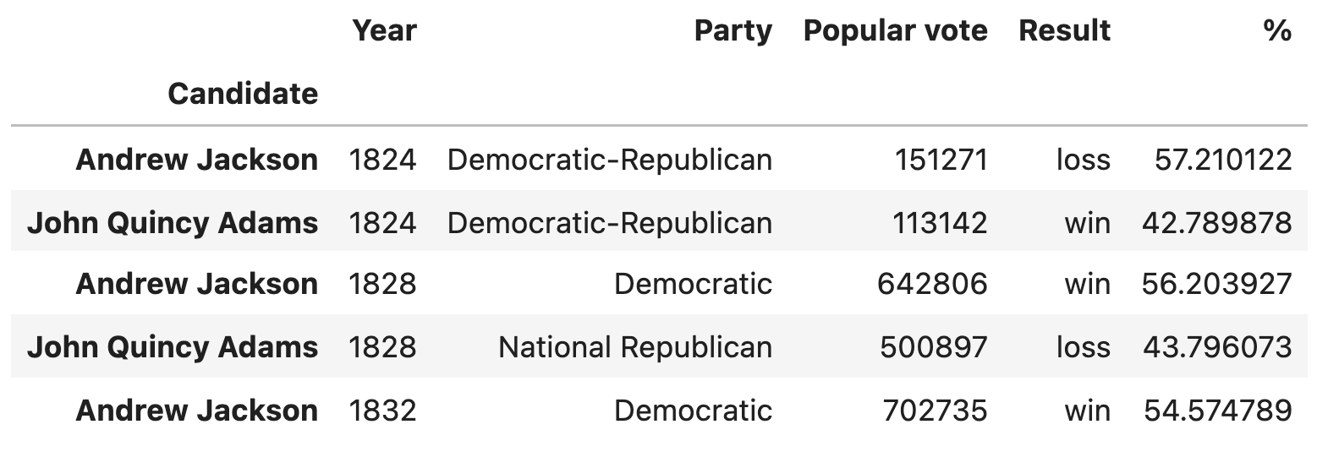
Indices Are Not Necessarily Row Numbers
An Index (a.k.a. row labels) can also:
Be non-numeric.
Have a name, e.g. "Candidate".
# Creating a DataFrame from a CSV file and specifying the Index column
elections = pd.read_csv("data/elections.csv", index_col = "Candidate")

Slide 27
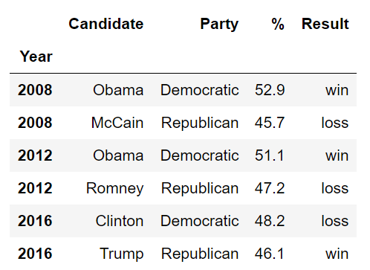
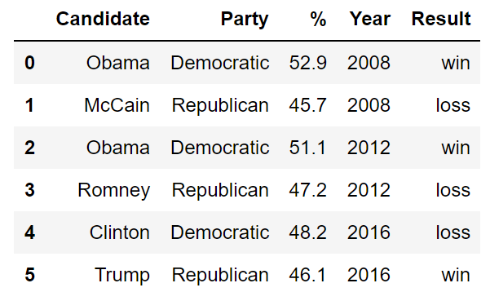
Indices Are Not Necessarily Unique
The row labels that constitute an index do not have to be unique.
Left: The index values are all unique and numeric, acting as a row number.
Right: The index values are named and non-unique.

Slide 28
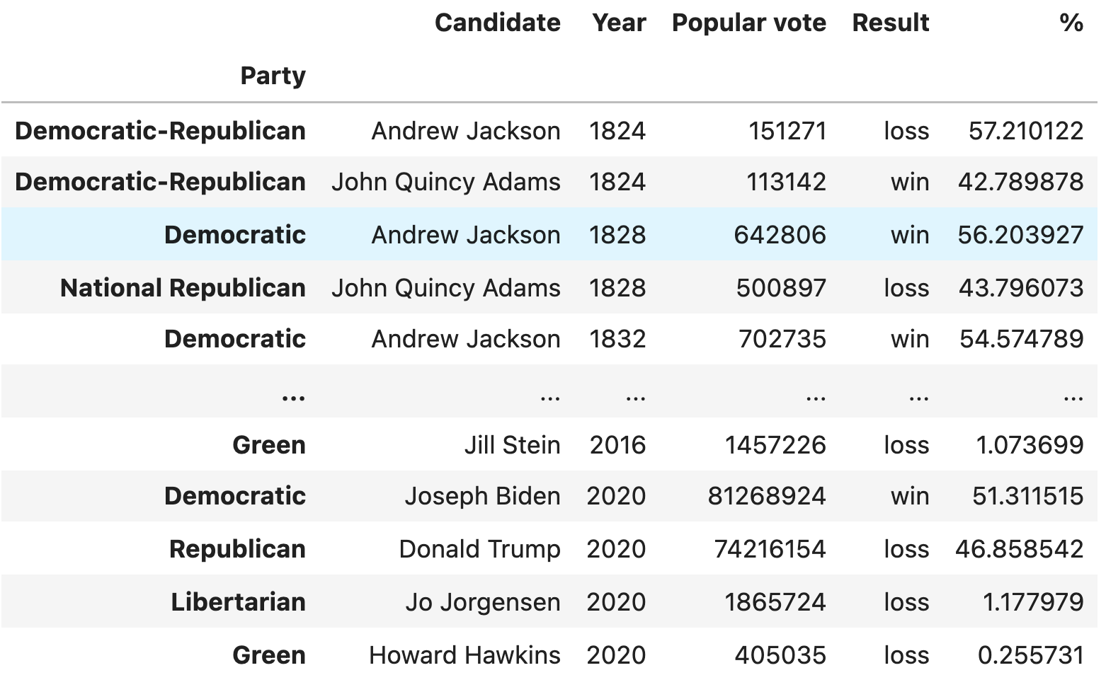
Modifying Indices
We can select a new column and set it as the index of the DataFrame.
Example: Setting the index to the "Party" column.
elections.set_index("Party")

Slide 29
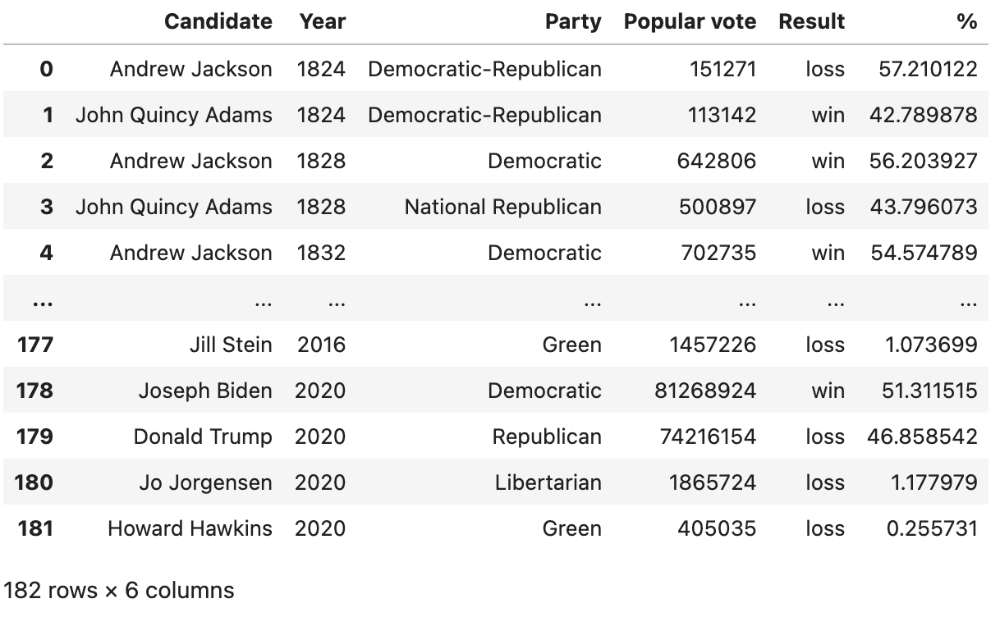
Resetting the Index
We can change our mind and reset the Index back to the default list of integers.
elections.reset_index()

Slide 30
Column Names Are Usually Unique!
Column names in pandas are almost always unique.
Example: Really shouldn’t have two columns named "Candidate".

Slide 31
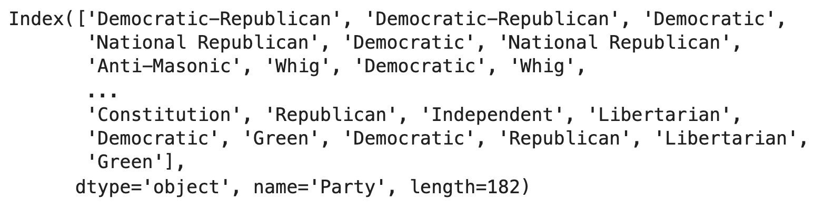
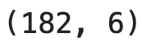
Retrieving the Index, Columns, and shape
Sometimes you'll want to extract the list of row and column labels.
For row labels, use DataFrame.index:
For column labels, use DataFrame.columns:
For shape of the DataFrame we use DataFrame.shape:
elections.set_index("Party")
elections.index
elections.columns
elections.shape

Slide 32
The Relationship Between DataFrames, Series, and Indices
We can think of a DataFrame as a collection of Series that all share the same Index.
Candidate, Party, %, Year, and Result Series all share an Index from 0 to 5.
Candidate Series
Party Series
% Series
Year Series
Result Series

Slide 33
The DataFrame API
The API for the DataFrame class is enormous.
API: "Application Programming Interface".
The API is the set of abstractions supported by the class.
Full documentation is at https://pandas.pydata.org/docs/reference/api/pandas.DataFrame.html
Compare with the Table class from Data8: http://data8.org/datascience/tables.html
We will only consider a tiny portion of this API.
We want you to get familiar with the real world programming practice of… Googling!
Answers to your questions are often found in the pandas documentation, Stack Overflow, etc.

Slide 34
Data Extraction with loc, iloc, and [ ]
Tabular data
DataFrames, Series, and Indices
Data extraction with loc, iloc, and []
Lecture 02, Data 100 Fall 2024

Slide 35
Extracting Data
One of the most basic tasks for manipulating a DataFrame is to extract rows and columns of interest. As we'll see, the large pandas API means there are many ways to do things.
Common ways we may want to extract data:
Grab the first or last n rows in the DataFrame.
Grab data with a certain label.
Grab data at a certain position.
We'll find that all three of these methods are useful to us in data manipulation tasks.

Slide 36
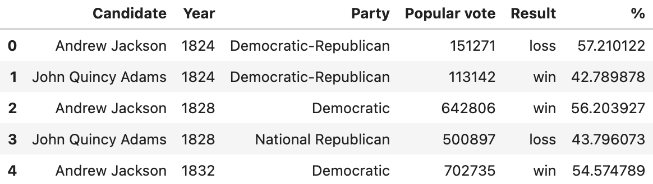
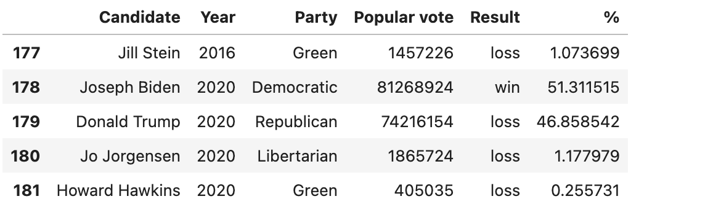
.head and .tail
The simplest scenarios: We want to extract the first or last n rows from the DataFrame.
df.head(n) will return the first n rows of the DataFrame df.
df.tail(n) will return the last n rows.
elections
elections.head(5)
elections.tail(5)

Slide 37
Label-based Extraction: .loc
A more complex task: We want to extract data with specific column or index labels.
The .loc accessor allows us to specify the labels of rows and columns we wish to extract.
We describe "labels" as the bolded text at the top and left of a DataFrame.
df.loc[row_labels, column_labels]
Column labels
Row labels

Slide 38
Label-based Extraction: .loc
Arguments to .loc can be:
A list.
A slice (syntax is inclusive of the right hand side of the slice).
A single value.

Slide 39
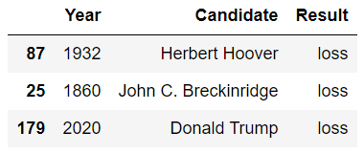
Label-based Extraction: .loc
Arguments to .loc can be:
A list.
A slice (syntax is inclusive of the right hand side of the slice).
A single value.
elections.loc[[87, 25, 179], ["Year", "Candidate", "Result"]]
Select the columns with labels "Year", "Candidate", and "Result".
Select the rows with labels 87, 25, and 179.

Slide 40
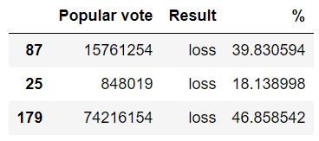
Label-based Extraction: .loc
Arguments to .loc can be:
A list.
A slice (syntax is inclusive of the right hand side of the slice).
A single value.
elections.loc[[87, 25, 179], "Popular vote":"%"]
Select all columns starting from "Popular vote" until "%".
Select the rows with labels 87, 25, and 179.

Slide 41
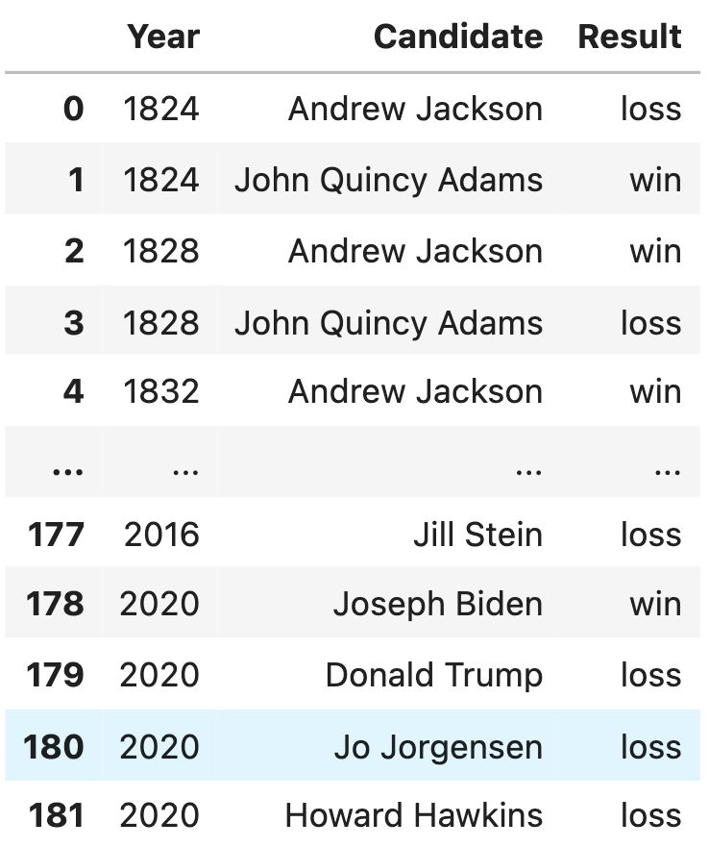
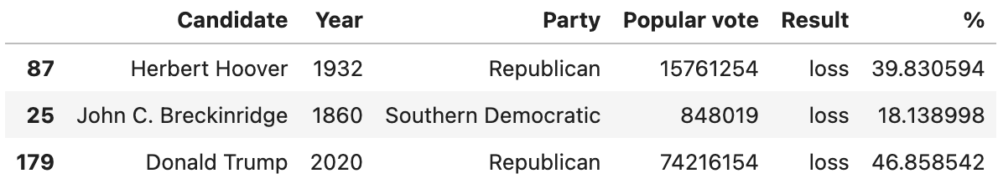
Label-based Extraction: .loc
To extract all rows or all columns, use a colon (:)
elections.loc[:, ["Year", "Candidate", "Result"]]
All rows for the columns with labels "Year", "Candidate", and "Result".
Ellipses (...) indicate more rows not shown.
elections.loc[[87, 25, 179], :]
All columns for the rows with labels 87, 25, 179.

Slide 42
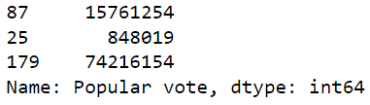

Label-based Extraction: .loc
Arguments to .loc can be:
A list.
A slice (syntax is inclusive of the right hand side of the slice).
A single value.
elections.loc[[87, 25, 179], "Popular vote"]
Wait, what? Why did everything get so ugly?
We've extracted a subset of the "Popular vote" column as a Series.
elections.loc[0, "Candidate"]
We've extracted the string value with row label 0 and column label "Candidate".

Slide 43
Pandas, Part II
LECTURE 3
More on Pandas (Utility Functions, Grouping, Aggregation)
Data 100/Data 200, Fall 2024 @ UC Berkeley
Narges Norouzi and Joseph E. Gonzalez

Slide 44
Goals for this Lecture
Continue our tour of pandas
Extracting data using .iloc and []
Extract data according to a condition
Modify columns in a DataFrame
Aggregate data
Last lecture: introducing tools
Today: "doing things"
Lecture 03, Data 100 Fall 2024

Slide 45
Agenda
Data extraction with loc, iloc, and []
Conditional selection
Adding, removing, and modifying columns
Useful utility functions
Custom sorts
Grouping
Lecture 03, Data 100 Fall 2024

Slide 46
Data Extraction with iloc and []
Data extraction with iloc, and []
Conditional selection
Adding, removing, and modifying columns
Useful utility functions
Custom sorts
Grouping
Lecture 03, Data 100 Fall 2024

Slide 47
Integer-based Extraction: .iloc
Arguments to .iloc can be:
A list.
A slice (syntax is exclusive of the right hand side of the slice).
A single value.

Slide 48
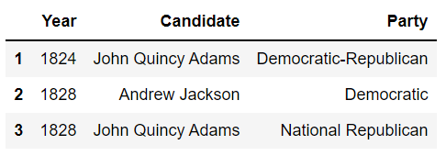
Integer-based Extraction: .iloc
Arguments to .iloc can be:
A list.
A slice (syntax is exclusive of the right hand side of the slice).
A single value.
elections.iloc[[1, 2, 3], [0, 1, 2]]
Select the columns at positions 0, 1, and 2.
Select the rows at positions 1, 2, and 3.

Slide 49
Integer-based Extraction: .iloc
Arguments to .iloc can be:
A list.
A slice (syntax is exclusive of the right hand side of the slice).
A single value.
elections.iloc[[1, 2, 3], 0:3]
Select all columns from integer 0 to integer 2.
Remember: integer-based slicing is right-end exclusive!
Select the rows at positions 1, 2, and 3.

Slide 50
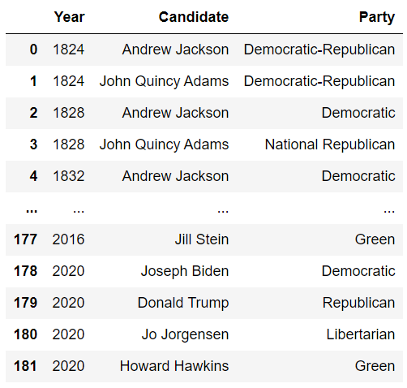
Integer-based Extraction: .iloc
Just like .loc, we can use a colon with .iloc to extract all rows or all columns.
elections.iloc[:, 0:3]
Grab all rows of the columns at integers 0 to 2.

Slide 51
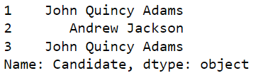
Integer-based Extraction: .iloc
Arguments to .iloc can be:
A list.
A slice (syntax is exclusive of the right hand side of the slice).
A single value.
elections.iloc[[1, 2, 3], 1]
As before, the result for a single value argument is a Series.
We have extracted row integers 1, 2, and 3 from the column at position 1.
elections.iloc[0, 1]
We've extracted the string value with row position 0 and column position 1.

Slide 52
.loc vs .iloc
Remember:
.loc performs label-based extraction
.iloc performs integer-based extraction
When choosing between .loc and .iloc, you'll usually choose .loc.
Safer: If the order of data gets shuffled in a public database, your code still works.
Readable: Easier to understand what elections.loc[:, ["Year", "Candidate", "Result"]] means than elections.iloc[:, [0, 1, 4]]
.iloc can still be useful.
Example: If you have a DataFrame of movie earnings sorted by earnings, can use .iloc to get the median earnings for a given year (index into the middle).

Slide 53

… Just When It Was All Making Sense
iloc
loc
[]

Slide 54
Context-dependent Extraction: [ ]
Selection operators:
.loc selects items by label. First argument is rows, second argument is columns.
.iloc selects items by integer. First argument is rows, second argument is columns.
[] only takes one argument, which may be:
A slice of row numbers.
A list of column labels.
A single column label.
That is, [] is context sensitive.
Let’s see some examples.

Slide 55
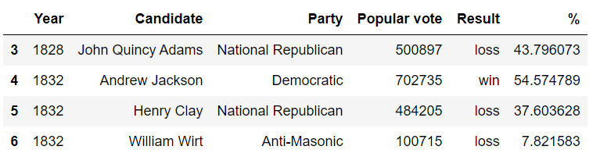
Context-dependent Extraction: [ ]
[] only takes one argument, which may be:
A slice of row integers.
A list of column labels.
A single column label.
elections[3:7]

Slide 56
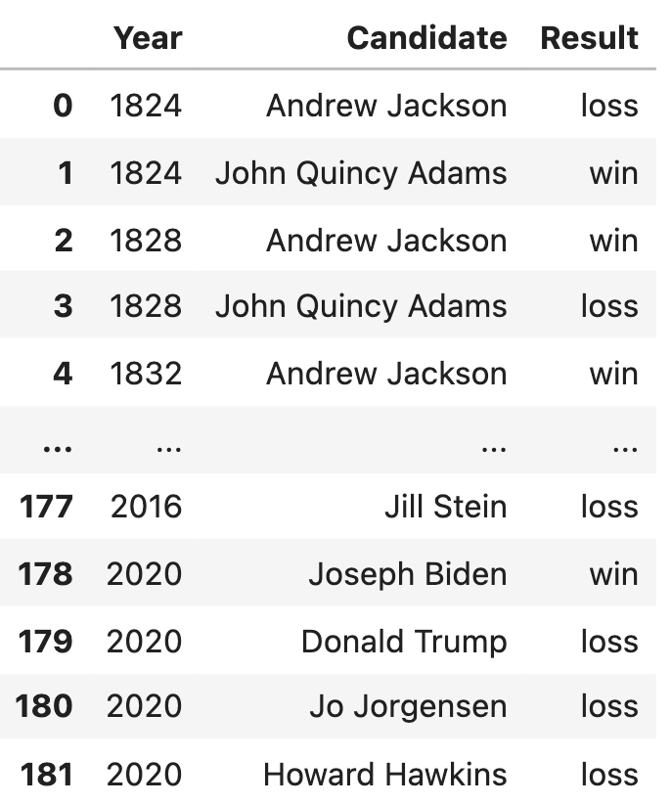
Context-dependent Extraction: [ ]
[] only takes one argument, which may be:
A slice of row numbers.
A list of column labels.
A single column label.
elections[["Year", "Candidate", "Result"]]

Slide 57
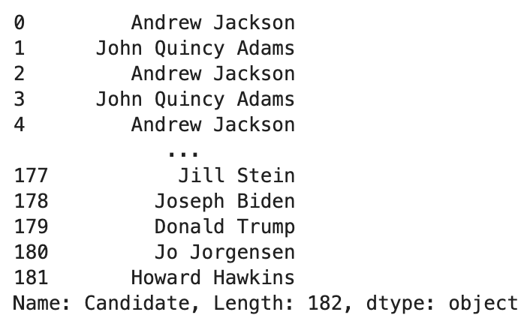
Context-dependent Extraction: [ ]
[] only takes one argument, which may be:
A slice of row numbers.
A list of column labels.
A single column label.
elections["Candidate"]
Extract the "Candidate" column as a Series.

Slide 58
Why Use []?
In short: [ ] can be much more concise than .loc or .iloc
Consider the case where we wish to extract the "Candidate" column. It is far simpler to write elections["Candidate"] than it is to write elections.loc[:, "Candidate"]
In practice, [ ] is often used over .iloc and .loc in data science work. Typing time adds up!

Slide 59
Conditional Selection
Data extraction with loc, iloc, and []
Conditional selection
Adding, removing, and modifying columns
Useful utility functions
Custom sorts
Grouping
Lecture 03, Data 100 Fall 2024

Slide 60
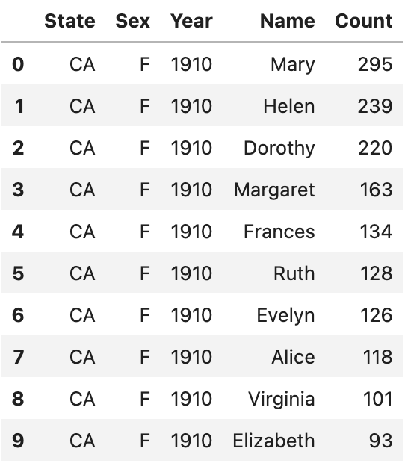
Boolean Array Input for .loc and [ ]
We learned to extract data according to its integer position (.iloc) or its label (.loc)
What if we want to extract rows that satisfy a given condition?
.loc and [ ] also accept boolean arrays as input.
Rows corresponding to True are extracted; rows corresponding to False are not.
babynames_first_10_rows = babynames.loc[:9, :]

Slide 61
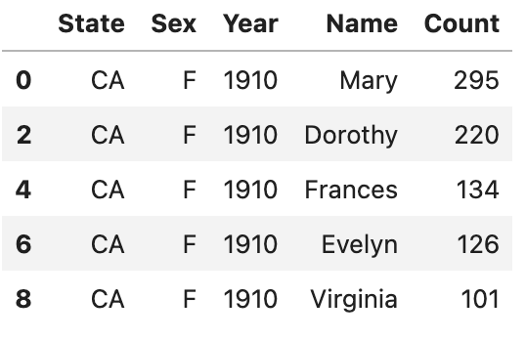
Boolean Array Input for .loc and [ ]
.loc and [ ] also accept boolean arrays as input.
Rows corresponding to True are extracted; rows corresponding to False are not.
babynames_first_10_rows[[True, False, True, False, True, False, True, False, True, False]]

Slide 62
Boolean Array Input
We can perform the same operation using .loc.
babynames_first_10_rows.loc[[True, False, True, False, True, False, True, False, True, False], :]

Slide 63
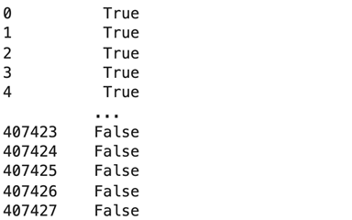
Boolean Array Input
Useful because boolean arrays can be generated by using logical operators on Series.
Length 407428 Series where every entry is either "True" or "False", where "True" occurs for every babyname with “Sex" = "F".
logical_operator = (babynames[“Sex"] == "F")
True in rows 0, 1, 2, …

Slide 64
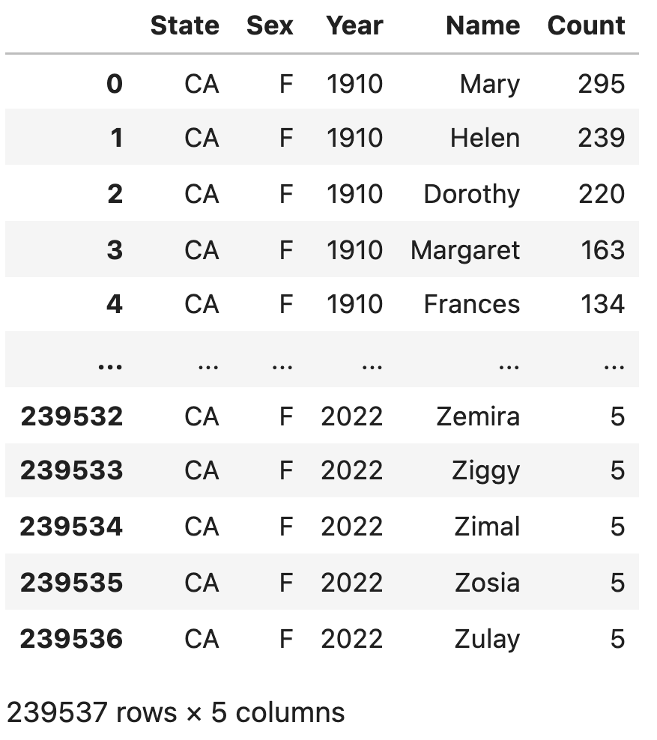
Boolean Array Input
Useful because boolean arrays can be generated by using logical operators on Series.
Length 239537 DataFrame where every entry belongs to a babyname with "Sex" = "F".
Length 407428 Series where every entry is either "True" or "False", where "True" occurs for every babyname with "Sex" = "F".
babynames[(babynames["Sex"] == "F")]

Slide 65
Boolean Array Input
Can also use .loc.
Length 239537 DataFrame where every entry belongs to a babyname with "Sex" = "F".
Length 407428 Series where every entry is either "True" or "False", where "True" occurs for every babyname with "Sex" = "F".
babynames.loc[babynames["Sex"] == "F", :]

Slide 66
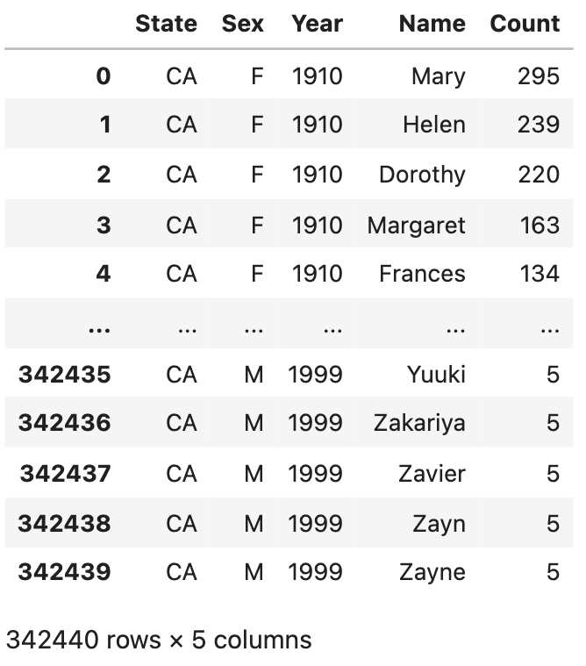
Boolean Array Input
Boolean Series can be combined using various operators, allowing filtering of results by multiple criteria.
The & operator allows us to apply logical_operator_1 and logical_operator_2
The | operator allows us to apply logical_operator_1 or logical_operator_2
babynames[(babynames["Sex"] == "F") | (babynames["Year"] < 2000)]
Rows that have a Sex of "F" or are earlier than the year 2000 (or both!)

Slide 67
Bitwise Operators
& and | are examples of bitwise operators. They allow us to apply multiple logical conditions.
If p and q are boolean arrays or Series:
Symbol | Usage | Meaning
~ | ~p | Negation of p
| | p | q | p OR q
& | p & q | p AND q
^ | p ^ q | p XOR q (exclusive or)

Slide 68
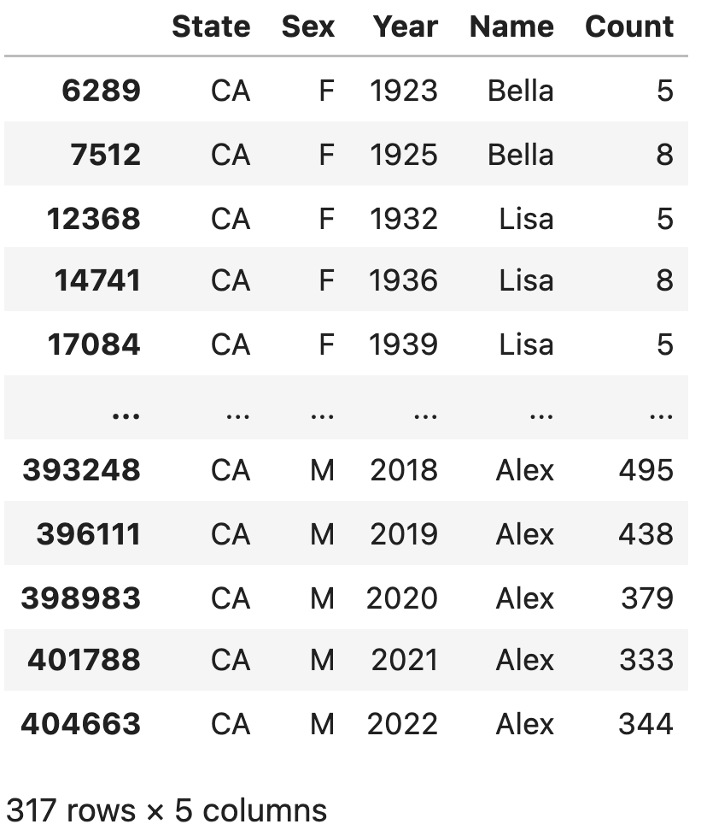
Alternatives to Direct Boolean Array Selection
Boolean array selection is a useful tool, but can lead to overly verbose code for complex conditions.
babynames[(babynames["Name"] == "Bella") |
(babynames["Name"] == "Alex") |
(babynames["Name"] == "Narges") |
(babynames["Name"] == "Lisa")]
pandas provides many alternatives, for example:
.isin
.str.startswith
.groupby.filter (we’ll see this in Lecture 4)

Slide 69
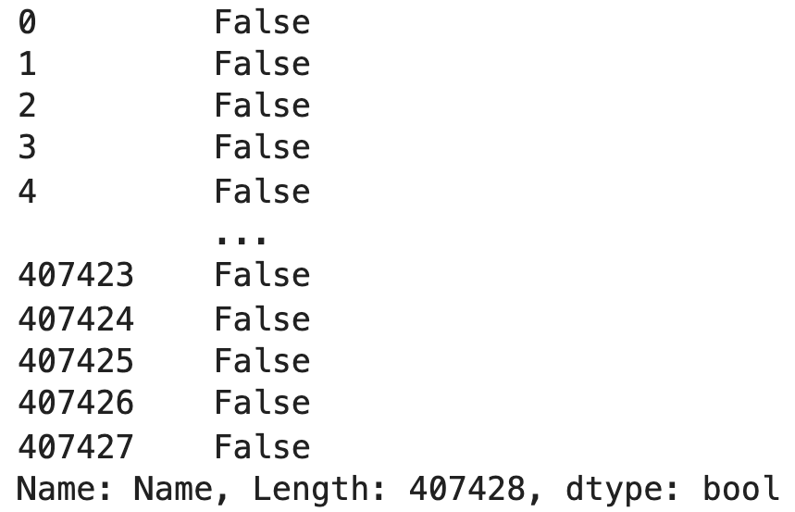
Alternatives to Direct Boolean Array Selection
pandas provides many alternatives, for example:
.isin
.str.startswith
.groupby.filter (see lecture 4)
names = ["Bella", "Alex", "Narges", "Lisa"]
babynames[babynames["Name"].isin(names)]
Returns a Boolean Series that is True when the corresponding name in babynames is Bella, Alex, Narges, or Lisa.

Slide 70
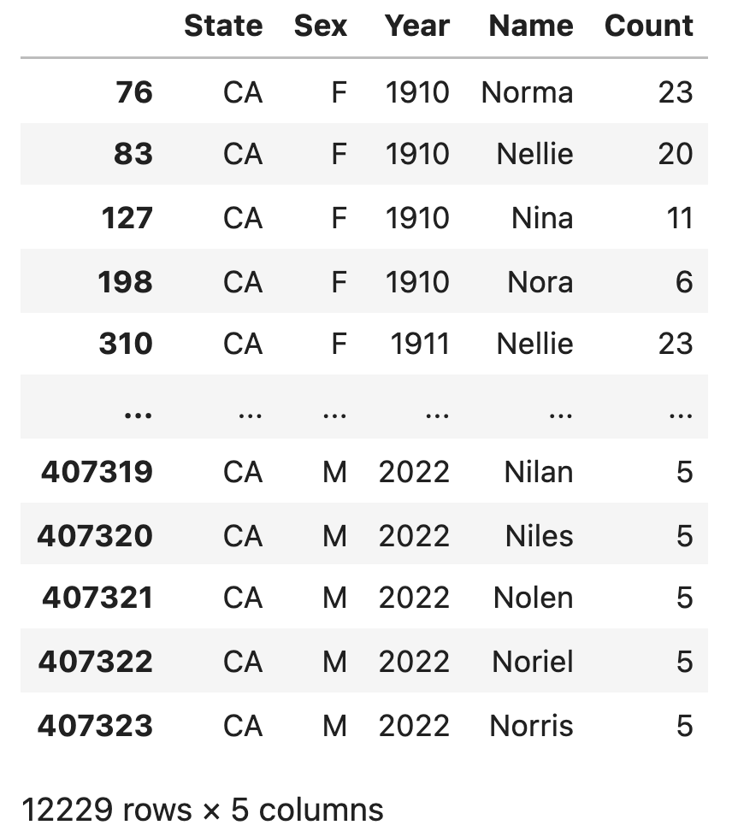
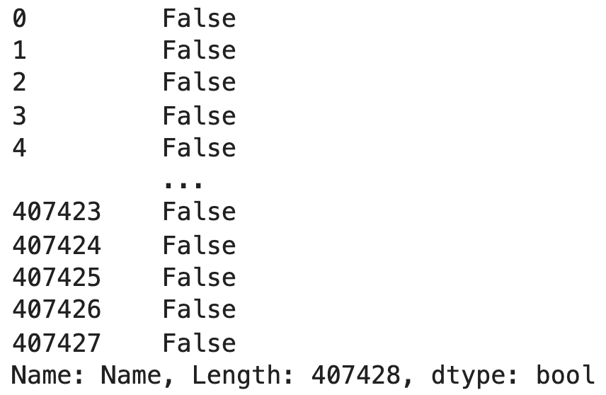
Alternatives to Boolean Array Selection
pandas provides many alternatives, for example:
.isin
.str.startswith
.groupby.filter (see lecture 4)
babynames[babynames["Name"].str.startswith("N")]
Returns a Boolean Series that is True when the corresponding name in babynames starts with "N".

Slide 71
Adding, Removing, and Modifying Columns
Data extraction with loc, iloc, and []
Conditional selection
Adding, removing, and modifying columns
Useful utility functions
Custom sorts
Grouping
Lecture 03, Data 100 Fall 2024

Slide 72

Syntax for Adding a Column
Adding a column is easy:
Use [ ] to reference the desired new column.
Assign this column to a Series or array of the appropriate length.
# Create a Series of the length of each name
babyname_lengths = babynames["Name"].str.len()
# Add a column named "name_lengths" that
# includes the length of each name
babynames["name_lengths"] = babyname_lengths

Slide 73

Syntax for Modifying a Column
Modifying a column is very similar to adding a column.
Use [ ] to reference the existing column.
Assign this column to a new Series or array of the appropriate length.
# Modify the "name_lengths" column to be one less than its original value
babynames["name_lengths"] = babynames["name_lengths"]-1

Slide 74

Syntax for Renaming a Column
Rename a column using the (creatively named) .rename() method.
.rename() takes in a dictionary that maps old column names to their new ones.
# Rename "name_lengths" to "Length"
babynames = babynames.rename(columns={"name_lengths":"Length"})

Slide 75

Syntax for Dropping a Column (or Row)
Remove columns using the (also creatively named) .drop method.
The .drop() method assumes you're dropping a row by default. Use axis="columns" to drop a column instead.
babynames = babynames.drop("Length", axis="columns")

Slide 76
An Important Note: DataFrame Copies
Notice that we re-assigned babynames to an updated value on the previous slide.
babynames = babynames.drop("Length", axis="columns")
By default, pandas methods create a copy of the DataFrame, without changing the original DataFrame at all. To apply our changes, we must update our DataFrame to this new, modified copy.
babynames.drop("Length", axis="columns")
babynames
Our change was not applied!

Slide 77
Useful Utility Functions
Data extraction with loc, iloc, and []
Conditional selection
Adding, removing, and modifying columns
Useful utility functions
Custom sorts
Grouping
Lecture 03, Data 100 Fall 2024

Slide 78

NumPy
Pandas Series and DataFrames support a large number of operations, including mathematical operations, so long as the data is numerical. Data 8 NumPy reference.
yash_count = babynames[babynames["Name"]=="Yash"]["Count"]
np.mean(yash_count)
17.142857142857142
np.max(yash_count)
29

Slide 79
Built-In pandas Methods
In addition to its rich syntax for indexing and support for other libraries (NumPy, native Python functions), pandas provides an enormous number of useful utility functions. Today, we’ll discuss just a few:
size/shape
describe
sample
value_counts
unique
sort_values
The pandas library is rich in utility functions (we could spend the entire summer talking about them)! We encourage you to explore as you complete your assignments by Googling and reading documentation, just as data scientists do.

Slide 80
.shape and .size
.shape returns the shape of a DataFrame or Series in the form (number of rows, number of columns.
.size returns the total number of entries in a DataFrame or Series (number of rows times number of columns).
babynames
babynames.shape
(407428, 5)
babynames.size
2037140

Slide 81

.describe()
.describe() returns a "description" of a DataFrame or Series that lists summary statistics of the data.
babynames
babynames.describe()

Slide 82

.describe()
A different set of statistics will be reported if .describe() is called on a Series.
babynames["Sex"].describe()

Slide 83



.sample()
To sample a random selection of rows from a DataFrame, we use the .sample() method.
By default, it is without replacement. Use replace=True for replacement.
Naturally, can be chained with other methods and operators (iloc, etc).
babynames.sample()
babynames.sample(5).iloc[:, 2:]
babynames[babynames["Year"]==2000]
.sample(4, replace=True)
.iloc[:, 2:]

Slide 84

.value_counts()
The Series.value_counts method counts the number of occurrences of each unique value in a Series (it counts the number of times each value appears).
Return value is also a Series.
babyname["Name"].value_counts()

Slide 85
.unique()
The Series.unique method returns an array of every unique value in a Series.
babynames["Name"].unique()

Slide 86

.sort_values()
The DataFrame.sort_values and Series.sort_values methods sort a DataFrame (or Series).
Series.sort_values( ) will automatically sort all values in the Series.
DataFrame.sort_values(column_name) must specify the name of the column to be used for sorting.
babynames["Name"].sort_values()

Slide 87

.sort_values()
The DataFrame.sort_values and Series.sort_values methods sort a DataFrame (or Series).
Series.sort_values( ) will automatically sort all values in the Series.
DataFrame.sort_values(column_name) must specify the name of the column to be used for sorting.
babynames.sort_values(by="Count", ascending=False)
By default, rows are sorted in ascending order.

Slide 88
Custom Sorts
Data extraction with loc, iloc, and []
Conditional selection
Adding, removing, and modifying columns
Useful utility functions
Custom sorts
Grouping
Lecture 03, Data 100 Fall 2024

Slide 89
Sorting By Length
Let’s try to solve the sorting problem with different approaches:
We will create a temporary column, then sort on it.

Slide 90

Approach 1: Create a Temporary Column and Sort Based on the New Column
Sorting the DataFrame as usual:
# Create a Series of the length of each name
babyname_lengths = babynames["Name"].str.len()
# Add a column named "name_lengths" that includes the length of each name
babynames["name_lengths"] = babyname_lengths
babynames = babynames.sort_values(by="name_lengths", ascending=False)
babynames.head(5)

Slide 91

Approach 2: Sorting Using the key Argument
babynames.sort_values("Name", key=lambda x: x.str.len(), ascending=False)
.head()

Slide 92

Approach 3: Sorting Using the map Function
Suppose we want to sort by the number of occurrences of "dr" and "ea"s.
Use the Series.map method.
def dr_ea_count(string):
return string.count('dr') + string.count('ea')
# Use map to apply dr_ea_count to each name in the "Name" column
babynames["dr_ea_count"] = babynames["Name"].map(dr_ea_count)
babynames = babynames.sort_values(by="dr_ea_count", ascending=False)
babynames.head()

Slide 93
Pandas, Part III
Advanced Pandas (Grouping, Aggregation, Pivot Tables, and Merging)
Data 100/Data 200, Fall 2024 @ UC Berkeley
Narges Norouzi and Joseph E. Gonzalez

Slide 94
Today’s Roadmap
Pandas, Part III
Groupby
Pivot Tables
Joining Tables
Lecture 4, Data 100 Fall 2024

Slide 95
Groupby
Pandas, Part III
Groupby
Pivot Tables
Joining Tables
Lecture 4, Data 100 Fall 2024

Slide 96
Why Group?
Our goal:
Group together rows that fall under the same category.
For example, group together all rows from the same year.
Perform an operation that aggregates across all rows in the category.
For example, sum up the total number of babies born in that year.
Grouping is a powerful tool to 1) perform large operations, all at once and 2) summarize trends in a dataset.

Slide 97

Visual Review of Data 8: Grouping and Collection

Slide 98

.groupby()
A .groupby() operation involves some combination of splitting the object, applying a function, and combining the results.
Calling .groupby() generates DataFrameGroupBy objects → "mini" sub-DataFrames
Each subframe contains all rows that correspond to the same group (here, a particular year)

Slide 99

.groupby().agg()
We cannot work directly with DataFrameGroupBy objects! The diagram below is to help understand what goes on conceptually – in reality, we can't "see" the result of calling .groupby.
Instead, we transform a DataFrameGroupBy object back into a DataFrame using .agg
.agg is how we apply an aggregation operation to the data.
Where did the non-numeric columns go? We’ll talk about this in a bit.

Slide 100
Putting It All Together
dataframe.groupby(column_name).agg(aggregation_function)
babynames[["Year", "Count"]].groupby("Year").agg(sum) computes the total number of babies born in each year.

Slide 101
Aggregation Functions
What goes inside of .agg( )?
Any function that aggregates several values into one summary value
Common examples:
In-Built Python Functions
NumPy Functions
In-Built pandas functions
.agg(sum) .agg(np.sum) .agg("sum")
.agg(max) .agg(np.max) .agg("max")
.agg(min) .agg(np.min) .agg("min")
.agg(np.mean) .agg("mean")
.agg("first")
.agg("last")
Some commonly-used aggregation functions can even be called directly, without the explicit use of .agg( )
babynames.groupby("Year").mean()

Slide 102

Alternatives …
Now, we create groups for each year.
babynames.groupby("Year")[["Count"]].agg(sum)
or
babynames.groupby("Year")[["Count"]].sum()
or
babynames.groupby("Year").sum(numeric_only=True)

Slide 103

Plotting Birth Counts
Plotting the DataFrame we just generated tells an interesting story.
babies_by_year = babynames.groupby("Year")[["Count"]].agg(sum)
px.line(babies_by_year, y="Count")

Slide 104
A Word of Warning!
We made an enormous assumption when we decided to use this dataset to estimate the birth rate.
According to https://lao.ca.gov/LAOEconTax/Article/Detail/691, the true number of babies born in California in 2020 was 421,275 but our plot shows 362,882 babies.
What happened?

Slide 105

Concluding groupby.agg
A groupby operation involves some combination of splitting the object, applying a function, and combining the results.
So far, we've seen that df.groupby("Year").agg(sum):
Split df into sub-DataFrames based on Year.
Apply the sum function to each column of each sub-DataFrame.
Combine the results of sum into a single DataFrame, indexed by Year.

Slide 106
Groupby Review Question
groupby
.agg(f), where f = max
A
3
ak
A
3
ak
A
1
hi
B
1
tx
A
2
ca
C
4
fl
A
1
hi
B
1
tx
A
3
??
B
5
mi
B
5
mi
B
6
??
C
9
ak
B
6
nc
C
9
??
A
2
ca
C
4
fl
C
5
sd
C
9
ak
B
6
nc
C
5
sd
What will go in the ??

Slide 107
Answer
groupby
.agg(f), where f = max
A
3
ak
A
3
ak
A
1
hi
B
1
tx
A
2
ca
C
4
fl
A
1
hi
B
1
tx
A
3
hi
B
5
mi
B
5
mi
B
6
tx
C
9
ak
B
6
nc
C
9
sd
A
2
ca
C
4
fl
C
5
sd
C
9
ak
B
6
nc
C
5
sd

Slide 108
Raw GroupBy Objects and Other Methods
The result of a groupby operation applied to a DataFrame is a DataFrameGroupBy object.
It is not a DataFrame!
grouped_by_year = elections.groupby("Year")
type(grouped_by_year)
pandas.core.groupby.generic.DataFrameGroupBy
Given a DataFrameGroupBy object, can use various functions to generate DataFrames (or Series). agg is only one choice:
df.groupby(col).mean()
df.groupby(col).sum()
df.groupby(col).min()
df.groupby(col).max()
df.groupby(col).first()
df.groupby(col).last()
df.groupby(col).size()
df.groupby(col).count()
df.groupby(col).filter()
🤨What’s the difference?
See https://pandas.pydata.org/docs/reference/groupby.html for a list of DataFrameGroupBy methods.

Slide 109
groupby.size() and groupby.count()
groupby("year")
.size()
1992
3
ak
1992
3
ak
1992
NaN
mi
Returns a Series object counting the number of rows in each group.
1996
1
tx
2000
4
fl
1996
1
hi
1996
1
tx
1992
2
1992
NaN
mi
1996
1
hi
1996
2
2000
9
NaN
2000
4
2000
4
fl
2000
2
ca
Similar to value_counts() except that size() does not sort the index based on the frequency of entries.
2000
9
NaN
2000
6
sd
2000
2
ca
2000
6
sd

Slide 110
groupby.size() and groupby.count()
groupby("year")
.count()
1992
3
ak
1992
3
ak
1992
NaN
mi
Returns a DataFrame with the counts of non-missing values in each column.
1996
1
tx
2000
4
fl
1996
1
hi
1996
1
tx
1992
1
2
1992
NaN
mi
1996
1
hi
1996
2
2
2000
9
NaN
2000
4
3
2000
4
fl
2000
2
ca
2000
9
NaN
2000
6
sd
2000
2
ca
2000
6
sd

Slide 111
Filtering by Group
Another common use for groups is to filter data.
groupby.filter takes an argument func.
func is a function that:
Takes a DataFrame as input.
Returns either True or False.
filter applies func to each group/sub-DataFrame:
If func returns True for a group, then all rows belonging to the group are preserved.
If func returns False for a group, then all rows belonging to that group are filtered out.
Notes:
Filtering is done per group, not per row. Different from boolean filtering.
Unlike agg(), the column we grouped on does NOT become the index!

Slide 112
groupby.filter()
groupby
num
.filter(f), where
f = lambda sf: sf["num"].sum() > 10
num
A
3
A
3
A
1
B
1
A
2
6
C
4
B
1
B
1
C
4
A
1
B
5
12
B
5
B
5
B
6
C
9
C
9
13
A
2
C
4
B
6
D
5
C
9
5
B
6
D
5

Slide 113

Filtering Elections Dataset
Going back to the elections dataset.
Let's keep only election year results where the max '%' is less than 45%.
elections.groupby("Year").filter(lambda sf: sf["%"].max() < 45)

Slide 114

groupby Puzzle
Puzzle: We want to know the best election by each party.
Best election: The election with the highest % of votes.
For example, Democrat’s best election was in 1964, with candidate Lyndon Johnson
winning 61.3% of votes.

Slide 115

Attempt #1
Why does the table seem to claim that Woodrow Wilson won the presidency in 2020?
elections.groupby("Party").max().head(10)

Slide 116
Problem with Attempt #1
Why does the table seem to claim that Woodrow Wilson won the presidency in 2020?
elections.groupby("Party").max().head(10)
Every column is calculated independently! Among Democrats:
Last year they ran: 2020.
Alphabetically the latest candidate name: Woodrow Wilson.
Highest % of vote: 61.34%.

Slide 117
Attempt #2: Motivation
We want to preserve entire rows, so we need an aggregate function that does that.

Slide 118
Raw GroupBy Objects and Other Methods
The result of a groupby operation applied to a DataFrame is a DataFrameGroupBy object.
It is not a DataFrame!
grouped_by_year = elections.groupby("Year")
type(grouped_by_year)
pandas.core.groupby.generic.DataFrameGroupBy
Given a DataFrameGroupBy object, can use various functions to generate DataFrames (or Series). agg is only one choice:
df.groupby(col).mean()
df.groupby(col).sum()
df.groupby(col).min()
df.groupby(col).max()
df.groupby(col).first()
df.groupby(col).last()
df.groupby(col).size()
df.groupby(col).count()
df.groupby(col).filter()

Slide 119
Attempt #2: Solution
.sort_values("%", ascending = False)
.groupby("Party")
.first()
Order is preserved in sub-DataFrames!
DR
1824
57%
Dem
1964
61%
Dem
1964
61%
DR
1824
43%
Dem
1936
60%
Dem
1936
60%
Dem
1828
56%
Rep
1972
60%
Nat
1828
44%
Rep
1920
60%
Rep
1972
60%
Dem
1964
61%
Dem
1832
54%
Rep
1984
59%
Rep
1920
60%
Rep
1972
60%
…
…
Rep
1984
59%
Green
2000
2.7%
Dem
2020
51%
Cons
2004
0.1%
Green
2020
0.2%
Rep
2020
47%
Pop
1992
0.1%
Green
2004
0.01%
Green
2020
0.2%
Green
2004
0.01%

Slide 120

Attempt #2: Solution
First sort the DataFrame so that rows are in descending order of %.
Then group by Party and take the first item of each sub-DataFrame.
Note: Lab will give you a chance to try this out if you didn't quite follow during lecture.
elections_sorted_by_percent = elections.sort_values("%", ascending=False)
elections_sorted_by_percent.groupby("Party").first()
elections_sorted_by_percent

Slide 121
groupby Puzzle - Alternate Approaches
Using a lambda function
elections_sorted_by_percent = elections.sort_values("%", ascending=False)
elections_sorted_by_percent.groupby("Party").agg(lambda x : x.iloc[0])
Using idxmax function
best_per_party = elections.loc[elections.groupby("Party")["%"].idxmax()]
Using drop_duplicates function
best_per_party2 = elections.sort_values("%").drop_duplicates(["Party"], keep="last")

Slide 122
There's More Than One Way to Find the Best Result by Party
In Pandas, there’s more than one way to get to the same answer.
Each approach has different tradeoffs in terms of readability, performance, memory consumption, complexity, etc.
Takes a very long time to understand these tradeoffs!
If you find your current solution to be particularly convoluted or hard to read, maybe try finding another way!

Slide 123


More on DataFrameGroupby Object
We can look into DataFrameGroupby objects in following ways:
grouped_by_party = elections.groupby("Party")
grouped_by_party.groups
grouped_by_party.get_group("Socialist")

Slide 124

Grouping by Multiple Columns
Suppose we want to build a table showing the total number of babies born of each sex in each year. One way is to groupby using both columns of interest:
babynames.groupby(["Year", "Sex"])[["Count"]].agg(sum).head(6)
Note: Resulting DataFrame is multi-indexed. That is, its index has multiple dimensions. Will explore in a later lecture.

Slide 125
Case Study: Analyzing Customer Purchasing Behaviour
A retail company, "ShopSmart," wants to understand customer purchasing behavior to optimize marketing strategies and improve customer satisfaction.
Consider following dataset
| Customer_ID | Customer_Age | Store_Location | Product_Category | Order_Total | Purchase_Date |
| --------------- | ----------------- | ----------------- | --------------------- | ------------- | ------------------ |
| 101 | 25 | New York | Electronics | 100.00 | 2022-01-01 |
| 101 | 25 | New York | Apparel | 50.00 | 2022-01-15 |
| 102 | 30 | Los Angeles | Home Decor | 200.00 | 2022-02-01 |
| 103 | 20 | Chicago | Electronics | 150.00 | 2022-03-01 |
And so on. How can we:
Identify top-selling product categories by store location.
Calculate average order total by customer age group.
Determine total sales by product category.

Slide 126
Pivot Tables
Grouping
Pivot Tables
Joining Tables
Lecture 4, Data 100 Fall 2024

Slide 127

Pivot Tables
A more natural approach is to do it by creating a pivot table.
babynames_pivot = babynames.pivot_table(
index = "Year", # rows (turned into index)
columns = "Sex", # column values
values = ["Count"], # field(s) to process in each group
aggfunc = np.sum, # group operation
)
babynames_pivot.head(6)

Slide 128
groupby(["Year", "Sex"]) vs. pivot_table
The pivot table more naturally represents our data.
groupby output
pivot_table output

Slide 129
Pivot Table Mechanics
f = sum
R
C
A
F
3
f
A
F
3
A
F
5
A
F
2
B
M
1
f
A
M
1
A
M
1
F
M
C
F
4
f
B
F
5
B
F
5
A
5
1
A
M
1
group
B
M
1
...
B
5
7
B
F
5
f
B
M
7
B
M
6
C
4
9
C
M
9
f
D
5
NaN
A
F
2
C
F
4
C
F
4
D
F
5
f
C
M
9
C
M
9
B
M
6
f
D
F
5
D
F
5

Slide 130

Pivot Tables with Multiple Values
We can include multiple values in our pivot tables.
babynames_pivot = babynames.pivot_table(
index = "Year", # rows (turned into index)
columns = "Sex", # column values
values = ["Count", "Name"],
aggfunc = np.max, # group operation
)
babynames_pivot.head(6)

Slide 131

Case Study: Sales Analysis for a Supermarket Chain
You are a data analyst for SuperMart, a nationwide supermarket chain. The management wants a detailed analysis of sales data to understand performance across stores, product categories, and months. The following dataset has been provided:
Business Questions to Answer
Find which store had the highest revenue in each month.
Identify the category with the most revenue in each store.
Which store has the highest average sales for electronics?

Slide 132
Join Tables
Grouping
Pivot Tables
Joining Tables
Lecture 4, Data 100 Fall 2024

Slide 133
Joining Tables
Suppose want to know the popularity of presidential candidate's names in 2022.
Example: Dwight Eisenhower's name Dwight is not popular today, with only 5 babies born with this name in California in 2022.
To solve this problem, we’ll have to join tables.
This will be almost exactly like Table.join from data 8 (Table.join - datascience 0.17.6 documentation)

Slide 134

Creating Table 1: Babynames in 2022
Let's set aside names in California from 2022 first:
babynames_2022 = babynames[babynames["Year"] == 2022]
babynames_2022

Slide 135

Creating Table 2: Presidents with First Names
To join our table, we’ll also need to set aside the first names of each candidate.
elections["First Name"] = elections["Candidate"].str.split().str[0]

Slide 136

Joining Our Tables: Two Options
merged = pd.merge(left = elections, right = babynames_2022,
left_on = "First Name", right_on = "Name")
merged = elections.merge(right = babynames_2022,
left_on = "First Name", right_on = "Name")

Slide 137
Case Study: Merging Employee and Department Data
You are a data analyst at Tech Solutions, a company that provides IT services. Your task is to analyze employee data and their respective departments. The company maintains separate datasets: one for employee details and another for department information. These datasets need to be merged to perform analysis on employee performance by department.
Business Questions to Answer
Employee-Department Overview: Combine employee information with the department names to analyze the salary distribution by department.
Employee Count by Department: Find out how many employees belong to each department.
Department Performance: Identify which departments are paying more on average to their employees.

Slide 138



Slide 139

Types of Merges
Inner Merge
Combine employee and department data,
keeping only the rows where there is a match in both datasets (based on DepartmentID).
For Example: We want to merge only employees who belong to valid departments in the department dataset
merged_data = pd.merge(employee_data, department_data, on='DepartmentID', how='inner')
All employees who have a valid department (DepartmentID 10, 20, or 30) are included.
Department name is added for each employee
No employee from a non existing department is included in the result

Slide 140
Types of Merges
Left Merge
Combine employee and department data, keeping all employees in the result, even if their DepartmentID doesn’t have a matching department in the department dataset.
We want to include all employees and still merge their department information if available.
merged_data = pd.merge(employee_data, department_data, on='DepartmentID', how='left')
All employees are included, and department names are merged where possible.
If there was an employee in a department that doesn’t exist in the department dataset (e.g. Department ID 40) then would return NaN for Department Name

Slide 141

Types of Merges
Right Merge
Combine employee and department data, keeping all departments in the result, even if some departments have no employees.
We want to keep all department information even if no employee is assigned to that department.
merged_data = pd.merge(employee_data, department_data, on='DepartmentID', how=‘right')
All departments are included, but since no employees belong to the Marketing department (id 40) it appearswith NaN values for EmployeeID and Salary

Slide 142

Types of Merges
Outer Merge
Combine employee and department data, keeping all rows from both datasets, and filling with NaN where applicable
For Example: We want to keep all employees and all departments, even if there is no matching records in the other dataset
merged_data = pd.merge(employee_data, department_data, on='DepartmentID', how=‘outer')
All rows from both datasets are included, even if there is no match
Some values appear with NaN where applicable

